Slide 1
Senior Capstone
Software Issue & Change Management
Requirements Document
Donald Akujobi
Raymond Lemon
Amber Dawkins
Matthew King
Wayne State University

Slide 2
Topics
Project Description
Software Requirements
Concept Attributes
Domain Model

Slide 3
Project Description
Current issue tracker systems (such as, Bugzilla) and version controls systems (such as GIT or SVN) are not very well integrated and used together by developers. In consequence it is difficult to link the exact code that was changed in response to an issue request and its description. In some systems, if developers are diligent in maintaining this information, then such data can be extracted automatically. However, for legacy systems, such information needs to be reverse engineered manually.

Slide 4
Users
Responsibility Description |  | Concept Name
Rs1. Access to any part of the system, has the ability to add and remove accounts |  | Admin User
Rs2. Has Read –Only access in the System |  | Non-Privileged User
Rs3. Has Read & Write Access in the System |  | Privileged User

Slide 5
System Roles
Admin Role
  Admin can add or remove trusted users, add/modify/view/download data from the repository
Primary actor: Admin User
Actor’s goals:
Adding or removing trusted users, modifying/adding/viewing/downloading of information about a System, System release, Report, Revision, Target file, or Target changes from one of the database tables
Preconditions:
  Data should be available within the system
  Data is correct/has been verified
Main tasks:
  Add/Remove trusted users from the system
  Reset login credentials
  Add/View information about the systems currently within the repository (Name, Version Control System URL, Issue Tracker URL, Programming Language)
  Add/View information about the release of the system (System Name, Release name)
  Add/View reports (System Name, Release Name, Id in Issue Tracker, Type i.e. Bug/Update, Report Title)
  Add/View revisions (System Name, Id in VCS, Comments)
  Add/View target file changes/updates (System Name, Release name, Report Id, File path, Change type, Revision)
  Add/View target Changes (System name, Release Name, Report Id, Granularity i.e. Method/Class, Qualified name i.e. hierarchical name of the object, function, or variable)
Post-conditions:
  User is either added to the system or removed
  Data is correct/has been verified
  Data is available for viewing/downloading by the public

Slide 6
System Roles
Trusted User Role
  Trusted users can add/modify/view/download data from the repository
Primary actor:
  Trusted users
Actor’s goals:
Modifying/adding/viewing/downloading of information about a System, System release, Report, Revision, Target file, or Target changes from one of the database tables
Preconditions:
  Data should be available within the system
  Data is correct/has been verified
Main tasks:
  Add/View information about the systems currently within the repository (Name, Version Control System URL, Issue Tracker URL, Programming Language)
  Add/View information about the release of the system (System Name, Release name)
  Add/View reports (System Name, Release Name, Id in Issue Tracker, Type i.e. Bug/Update, Report Title)
  Add/View revisions (System Name, Id in VCS, Comments)
  Add/View target file changes/updates (System Name, Release name, Report Id, File path, Change type, Revision)
  Add/View target Changes (System name, Release Name, Report Id, Granularity i.e. Method/Class, Qualified name i.e. hierarchical name of the object, function, or variable)
Post-conditions:
  Data is correct/has been verified
  Data is available for viewing/downloading by the public

Slide 7
System Roles
Non Trusted User
  Public user can view/download data from the repository
Primary actor:
  Public users who do not have data modification/adding privileges
Actor’s goals:
  Viewing/downloading of information about a System, System release, Report, Revision, Target file, or Target changes from one of the database tables
Preconditions:
  Data should be available within the system
  Data is correct/has been verified
Main tasks:
  View information about the systems currently within the repository (Name, Version Control System URL, Issue Tracker URL, Programming Language)
  View information about the release of the system (System Name, Release name)
  View reports (System Name, Release Name, Id in Issue Tracker, Type i.e. Bug/Update, Report Title)
  View revisions (System Name, Id in VCS, Comments)
  View target file changes/updates (System Name, Release name, Report Id, File path, Change type, Revision)
  View target Changes (System name, Release Name, Report Id, Granularity i.e. Method/Class, Qualified name i.e. hierarchical name of the object, function, or variable)

Slide 8
Use Case UC-1: |  |  | Add New System
Related Use Cases: |  |  | UC3, UC5, UC7, UC9, UC11
Initiating Actor: |  |  | Any of: Trusted Users, Admin
Actor’s Goal: |  |  | To add information for a new system to the repository
Participating Actors: |  |  | Database, Admin, Trusted Users
Preconditions: |  |  | Trusted User/Admin is currently logged in the system and is shown a hyperlink “Add New System.”
Postconditions: |  |  | The newly added system is now viewable to all visitors of the site
Flow of Events for Main Success Scenario:
→ | 1. | Trusted User/Admin clicks the hyperlink “Add New System”
← | 2. | System prompts the Trusted User/Admin for the Name, Version Control System URL, Issue Tracker URL, and Programming Language of the System
→ | 3. | Trusted User/Admin enters the system information and clicks submit
← | 4. | System updates the records in the Database
→ | 5. | System displays the updated information on the “View Systems” page

Slide 9
Use Case 2: View Systems
Use Case UC-2: |  |  | View System
Related Use Cases: |  |  | UC4, UC6, UC8, UC10, UC12
Initiating Actor: |  |  | Any of: Trusted Users, Public Users, Admin
Actor’s Goal: |  |  | To view information about the systems stored within the repository
Participating Actors: |  |  | Database, Admin, Trusted Users, Public Users
Preconditions: |  |  | Trusted User/Admin/Public User currently has access to the system and is shown a “View Systems” Hyperlink
Postconditions: |  |  | The systems information table of the database is viewable to all visitors of the site
Flow of Events for Main Success Scenario:
→ | 1. | Trusted User/Admin/Public User clicks the hyperlink “View Systems”
→ | 2. | System displays the most up to date information on the “View Systems” page

Slide 10
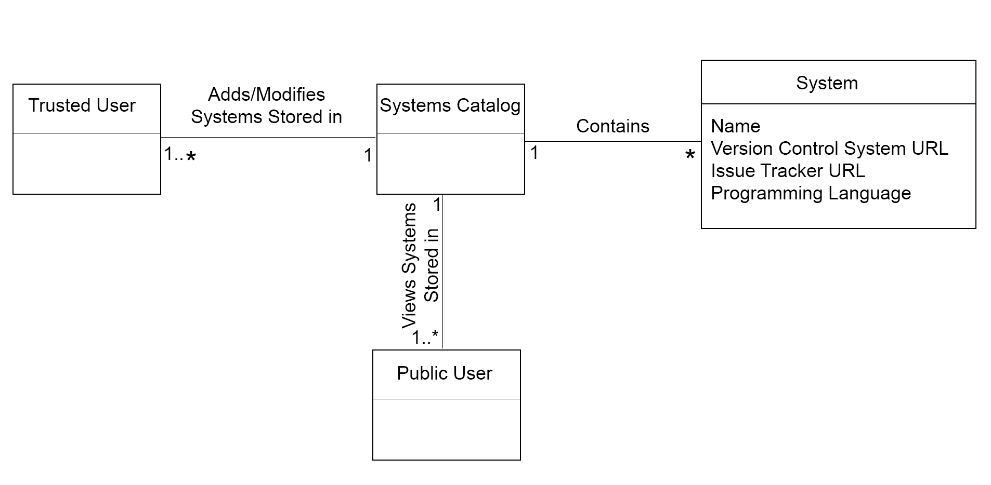
Domain Model

Slide 11
Use Case UC-3: |  |  | Add New System Release
Related Use Cases: |  |  | UC1, UC5, UC7, UC9, UC11
Initiating Actor: |  |  | Any of: Trusted Users, Admin
Actor’s Goal: |  |  | To add release information for a system stored within the repository
Participating Actors: |  |  | Database, Admin, Trusted Users
Preconditions: |  |  | Trusted User/Admin is currently logged in the system and is shown a hyperlink “Add New System Release.”, Previous release of the system already exist within the System information table
Postconditions: |  |  | The newly added system release is now viewable to all visitors of the site
Flow of Events for Main Success Scenario:
→ | 1. | Trusted User/Admin clicks the hyperlink “Add New System Release”
← | 2. | System prompts the Trusted User/Admin for the System Name and System Release of the System
→ | 3. | Trusted User/Admin enters the system information and clicks submit
← | 4. | System verifies that a previous release of the system is present within the “System Information” table
← | 5. | System updates the records of the “System Release” table in the Database
→ | 6. | System displays the updated information on the “View Systems” page

Slide 12
Use Case UC-4: |  |  | View System Release
Related Use Cases: |  |  | UC4, UC6, UC8, UC10, UC12
Initiating Actor: |  |  | Any of: Trusted Users, Public Users, Admin
Actor’s Goal: |  |  | To view information about the release of a system stored within the repository
Participating Actors: |  |  | Database, Admin, Trusted Users, Public Users
Preconditions: |  |  | Trusted User/Admin/Public User currently has access to the system and is shown a “View System Release” Hyperlink
Postconditions: |  |  | The systems information table of the database is viewable to all visitors of the site
Flow of Events for Main Success Scenario:
→ | 1. | Trusted User/Admin/Public User clicks the hyperlink “View System Release”
→ | 2. | System displays the most up to date information on the “View System Release” page

Slide 13
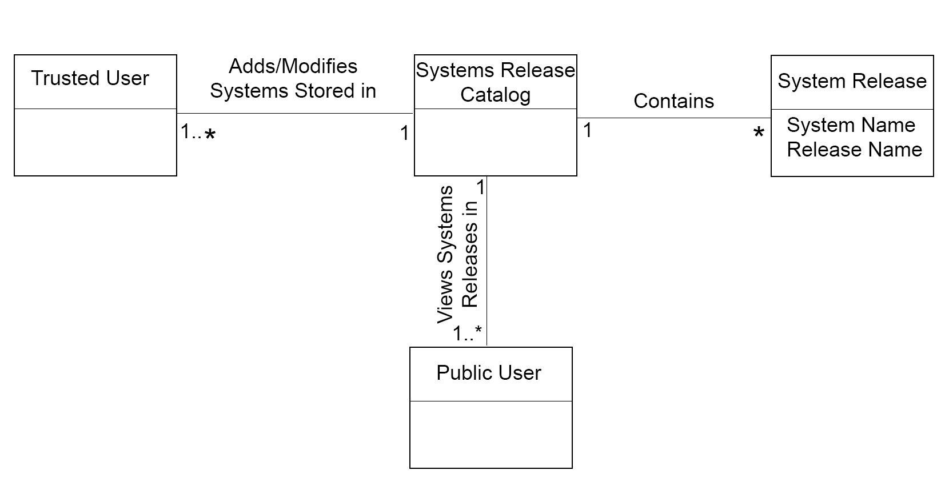
Domain Model

Slide 14
Use Case 1: Unlock
Use Case UC-7: |  |  | Add A New Revision
Related Requirements: |  |  | UC1, UC3, UC5, UC9 and UC11
Initiating Actor: |  |  | Admin and Privileged User
Actor’s Goal: |  |  | To add a new report in the system that has a name, ID, and section for comments
Participating Actors: |  |  | Repository
Preconditions: |  |  | • There must be a name of the system • There must be a ID of the report
Postconditions: |  |  | The report is added with a corresponding ID to the system
Flow of Events for Main Success Scenario:
→ | 1. | Admin or Privileged User
 | 2. | include::Authenticate User (UC-7)
← | 3. | There must be a name and ID of report
← | 4. | The report is added correctly in the system

Slide 15
Use Case UC-8: |  |  | Show Revision
Related Requirements: |  |  | UC2,UC4, UC6, UC10 and UC12
Initiating Actor: |  |  | Admin, Privileged or Non Privileged User
Actor’s Goal: |  |  | View the Revision Report
Participating Actors: |  |  | Repository
Preconditions: |  |  | • There must be a name of the system • There must be a ID of the report
Postconditions: |  |  | The report is shown in the screen with the correct information
Flow of Events for Main Success Scenario:
→ | 1. | Admin, Privileged or Non Privileged User
 | 2. | include::AuthenticateUser (UC-8)
← | 3. | There must be a name and ID of report
← | 4. | The report and correct information is shown in the screen
Use Case 1: Unlock

Slide 16
Use Case UC-9: |  |  | Add A New Target File
Related Requirements: |  |  | UC1, UC3, UC5, UC7 and UC11
Initiating Actor: |  |  | Admin or Privileged User
Actor’s Goal: |  |  | Add A New Target File
Participating Actors: |  |  | Repository
Preconditions: |  |  | • There must be a name of the system • There must be a release name • There must be a report ID • There must be a File Path • There must be a Revision Status • There must be a Change Type
Postconditions: |  |  | A correct Target File is added
Flow of Events for Main Success Scenario:
→ | 1. | Admin, Privileged or Non Privileged User
 | 2. | include::AuthenticateUser (UC9)
← | 3. | Click the drop down list next to “System Name” and select the system you would like to use. If it does not exist then you need to click the “Add new system” link to the right to add a new system. If you have to add a new system you need to fill out the form the “System Manager” form that shows up and then click “Add System”.
 | 4. | Click the drop down list next to “Release Name” and select the release you would like to use. If it does not exist, you need to click the “Add new system release” link to the right to add a new release. If you have to add a new system you need to fill out the “System Manager” form that shows up and then click “Add System Release”.
 | 5. | Click the drop down list next to “Report Id” and select the release you would like to use. If it does not exist, you need to click the “Add new report” link to the right to add a new release. If you have to add a new report you need to fill out the “Report Manager” form that shows up and then click “Add Report”.
 | 6. | Copy and paste the exact file path into the text box next to “File Path”.
 | 7. | Click the drop down list next to “Revision” and select the revision number that you want. If it does not exist, you need to click the “Add new revision” link to the right to add a new revision. If you have to add a new revision, you need to fill out the “Revision Manager” form that shows up and then click “Add Revision”.
 | 8 | Click the drop down list next to “Change Type” and select the option added, modified, or deleted depending on which action you completing.
 | 9. | Click the “Add Target File” button to complete your action.
← | 10. | To make sure that your file was added correctly, On the home page click the “Show target files” link. You should then be able to see if the “Target File” was properly added into the system.

Slide 17
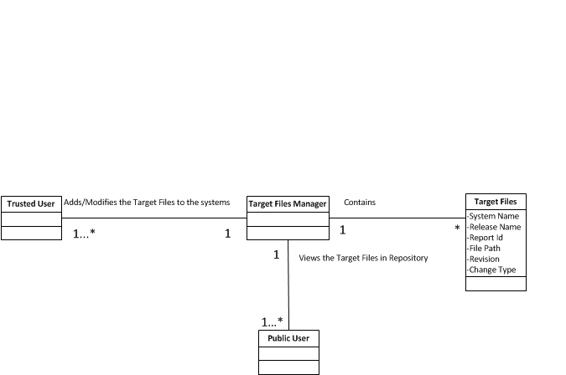
Add a new Target File

Slide 18
Use Case UC-10: |  |  | Show A New Target File
Related Requirements: |  |  | UC2, UC4, UC6, UC8 and UC12
Initiating Actor: |  |  | Admin, Privileged User or Non Privileged User
Actor’s Goal: |  |  | Show A new Target File
Participating Actors: |  |  | Repository
Preconditions: |  |  | • There must be a name of the system • There must be a release name • There must be a report ID • There must be a File Path • There must be a Revision Status • There must be a Change Type
Postconditions: |  |  | A correct Target File is shown in the Screen
Flow of Events for Main Success Scenario:
→ | 1. | Admin, Privileged or Non Privileged User
 | 2. | include::AuthenticateUser (UC9)
 | 3. | Go to the home page that shows all the links to the repository.
 | 4. | Click on the “Show target files” link under the Target Files heading.
 | 5. | A list should appear and your added file should be listed.

Slide 19
Use Case UC-11: |  |  | Add A New Target File (Change Manager)
Related Requirements: |  |  | UC1, UC3, UC5, UC7 and UC11
Initiating Actor: |  |  | Admin or Privileged User
Actor’s Goal: |  |  | Add A New Target File (Change Manager)
Participating Actors: |  |  | Repository
Preconditions: |  |  | • There must be a name of the system • There must be a release name • There must be a report ID • There must be a File Path • There must be a Granularity Type • There must be a Change Type
Postconditions: |  |  | A correct Target File is added
Flow of Events for Main Success Scenario:
→ | 1. | Admin, Privileged or Non Privileged User
 | 2. | include::AuthenticateUser (UC9)
← | 3. | Click the drop down list next to “System Name” and select the system you would like to use. If it does not exist then you need to click the “Add new system” link to the right to add a new system. If you have to add a new system you need to fill out the form the “System Manager” form that shows up and then click “Add System”.
← | 4. | Click the drop down list next to “Release Name” and select the release you would like to use. If it does not exist, you need to click the “Add new system release” link to the right to add a new release. If you have to add a new system you need to fill out the “System Manager” form that shows up and then click “Add System Release”.
 | 5. | Click the drop down list next to “Report Id” and select the release you would like to use. If it does not exist, you need to click the “Add new report” link to the right to add a new release. If you have to add a new report you need to fill out the “Report Manager” form that shows up and then click “Add Report”.
 | 6. | Click the drop down list next to “File Path” and select the file path you would like to use. If it does not exist, you need to click the “Add new report” link to the right to add a new release. IF you have to add a new report you need to fill out the “Target File Manager” form that shows up and then click “Add Target File”.
 | 7. | Click the drop down list next to “Granularity” and select the class or method.
 |  | Click inside the text box next to “Qualified name” and enter a valid name.
 | 8 | Click the drop down list next to “Change Type” and select the option added, modified, or deleted depending on which action you completing.
 | 9. | Click the “Add Change” button to complete your action.
 | 10. | To make sure that your file was added correctly, On the home page click the “Show target files” link. You should then be able to see if the “Target File” was properly added into the system.

Slide 20
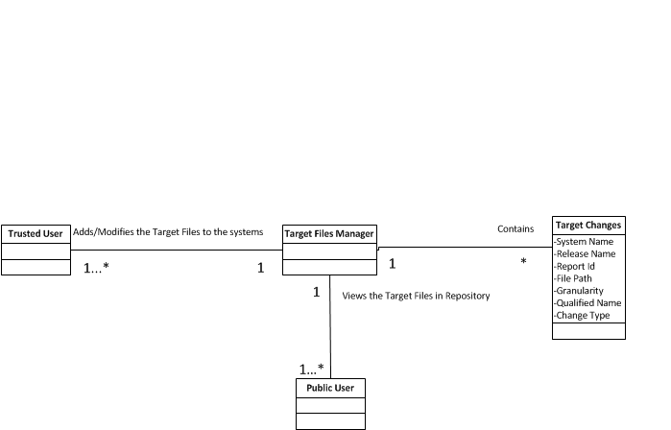
Add a new Target File (Change Manager)

Slide 21
Use Case UC-12: |  |  | Show A New Target File (Change Manager)
Related Requirements: |  |  | UC2, UC4, UC6, UC8 and UC10
Initiating Actor: |  |  | Admin, Privileged User, or Non Privileged User
Actor’s Goal: |  |  | Show A New Target File (Change Manager)
Participating Actors: |  |  | Repository
Preconditions: |  |  | • There must be a name of the system • There must be a release name • There must be a report ID • There must be a File Path • There must be a Granularity Type • There must be a Change Type
Postconditions: |  |  | A correct Target File is Shown
Flow of Events for Main Success Scenario:
→ | 1. | Admin, Privileged or Non Privileged User
 | 2. | include::AuthenticateUser (UC9)
← | 3. | Go to the home page that shows all the links to the repository.
← | 4. | Click on the “Show target files” link under the Target Files heading.
 | 5. | A list should appear and your added file should be listed.

Slide 22
Use Case UC-13: |  |  | Remove A User
Related Requirements: |  |  | UC 13
Initiating Actor: |  |  | Admin
Actor’s Goal: |  |  | Delete a User
Participating Actors: |  |  | Repository
Preconditions: |  |  | The User must exist in the system
Postconditions: |  |  | User Deleted
Flow of Events for Main Success Scenario:
→ | 1. | Admin
 | 2. | include::AuthenticateUser (UC9)
← | 3. | There must be a user
← | 4. | User Deleted

Slide 23
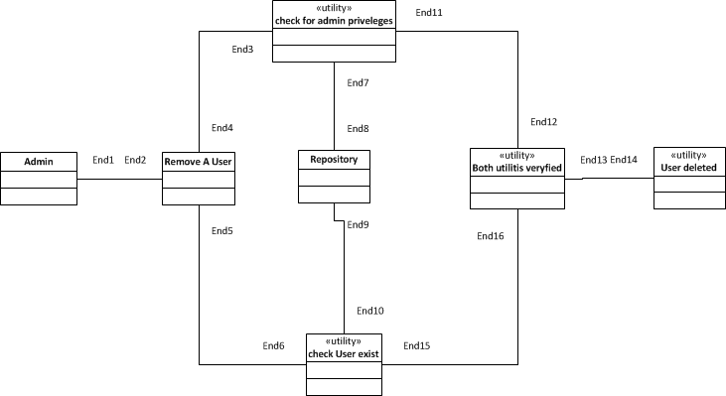
Domain model for UC-13: Remove A User
Associations: who needs to work together, not how they work together
Concept pair | Association description | Association name

Slide 24
Use Case UC-14: |  |  | Add A User
Related Requirements: |  |  | UC 14
Initiating Actor: |  |  | Admin
Actor’s Goal: |  |  | Add a User
Participating Actors: |  |  | Repository
Preconditions: |  |  | There must be an admin
Postconditions: |  |  | User Added
Flow of Events for Main Success Scenario:
→ | 1. | Admin
 | 2. | include::AuthenticateUser (UC9)
← | 3. | There must be a Admin
← | 4. | User Added

Slide 25
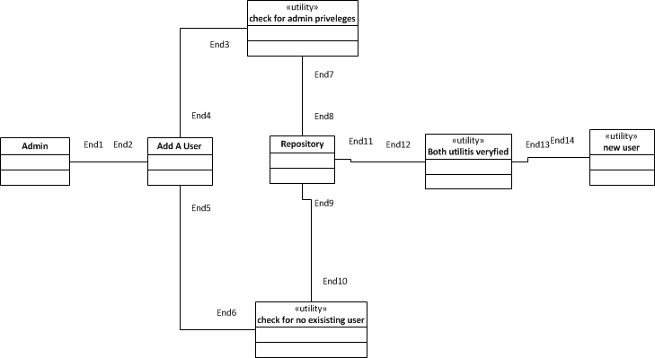
Domain model for UC-14: Add A New User

Slide 26
Architecture/Technology
Presentation/UI:
HTML5
JavaScript
CSS3(Twitter Bootstrap)
MVC Framework: Spring/JSF
Database: MySQL
Development Environment tools:
Apache Tomcat (server)
Maven (project structure and dependencies)
IDE: ECLIPSE

Slide 27
First Iteration
-Implement the front end view for Admin, Trusted Users, and Non Trusted Users
-Use Case 1 & 2
Link to current system: http://35.16.37.38:8080/severe-issues/

Slide 28
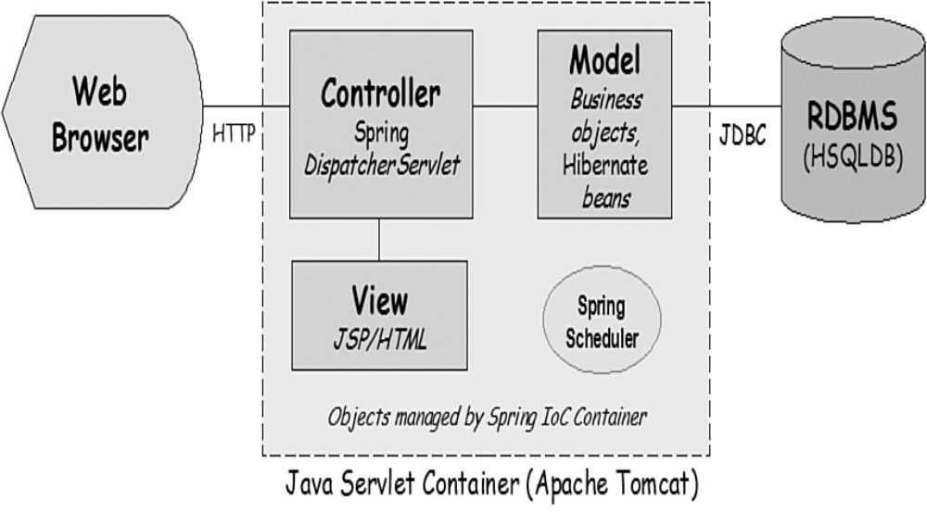
System Architecture

